Slide 1
VERTIGO
Controlling a Smartphone
from an
Architectural Vantage Point
Kirk Swidowski
mail kirk@swidowski.com
web www.de7ec7ed.com
twitter de7ec7ed
github github.com/de7ec7ed
Special thanks to Dr. Joseph Sharkey for his help with the project

Slide 2
About me
Principal Scientist at Siege Technologies
Expertise includes:
Virtualization (x86 [Intel-VT/AMD SVM] and ARM)
Trusted Computing (Intel TXT, ARM TrustZone, TPM)
Boot Technologies
Computer Architecture
Reverse Engineering
Prior work includes research & development on topics including:
Anti-Exploitation Protection Systems
Preventing Sensitive Information and Malicious Traffic from Leaving Computers
Dynamic Rooted Trust
M.S. Computer Science
Focused on the design and construction of a pedagogical RISC based computer architecture, including the ISA, 4 stage scalar pipeline with branch prediction and precise exception/interrupt handling (presented at CCSCNE 2009)
Mobile software was published in “A Windows Mobile Wish List”, Smartphone & PocketPC Magazine

Slide 3
Agenda
The Point Up Front
Usage
Background
Microvisor Overview
Kernel’s Key Enabling Components
Loaders Exposed
Modules & Management
Debugging Facilities
Construction & Layout
Questions
Lots of content, the hope is that they will be used as reference material after the presentation

Slide 4
The Point Up Front
To provide an extendable microvisor, for the ARM architecture, that can be used for a variety of activities
Expose the tool and techniques so they can’t be used for malicious things
Show that software can be constructed and compatible with an architecture instead of an OS
Recently Open Sourced and Released under GPL so others have a solid foundation to learn from and build upon
Others have discussed thin virtualization for x86 (e.g. SubVirt, Vitrol, BluePill, VirtDbg) and ARM (e.g. Cloaker)
Source code is unavailable for BluePill (available for BlackHat training only), Cloaker and Vitrol
Messy code that is not meant to be extended (magic numbers, not separated from the underlying OS correctly, no modularity, etc.)
Represents a different paradigm of compatibility
(Architecture instead of an Operating System)

Slide 5
Usage
Reverse Engineering
Enhanced Security
Perform dynamic analysis (underlying OS user and kernel space)
Dump register and memory state a key points in time
Trap on memory read/write (watchpoints)
Trap on execution (breakpoints)
Exception/Interrupt Injection
Debug kernel panics without the need of expensive hardware (e.g. JTAG) or built-in debuggers, such as KDB
Discover undocumented hardware
Create drivers to manipulate them
Dump and manipulate the page tables of an underlying OS
Show pages matching a particular set of attributes (e.g. cache, buffered, user, kernel, execute never, etc.)
Protect an applications memory when it is not executing
Inject an arbitrary application into the underlying OS
Exposed as a virtual file under the “/proc” file system (not located on non-volatile storage at runtime)
Executed by hooking the schedule() function in the kernel
Provide “out of band” functionality, such as integrity checks in a generic OS agnostic way
Advanced research in reverse engineering and security requires advanced tools, the hope is for the microvisor to provide an extendable foundation

Slide 6
Background
Describes the different types of hyper- /micro- visors and their position in a system’s software stack.

Slide 7
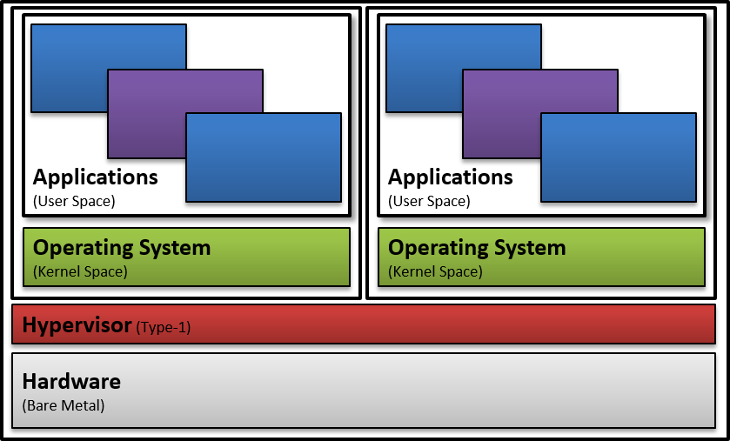
Type-1 Hypervisors
Resides under all operating systems, on the hardware (e.g. native or bare metal)
Existing Products:
VMware ESXi
Xen
Microsoft Hyper-V
KVM (kind of)
Can leverage hardware facilities (e.g. ARM VE, Intel VT or AMD SVM)

Slide 8
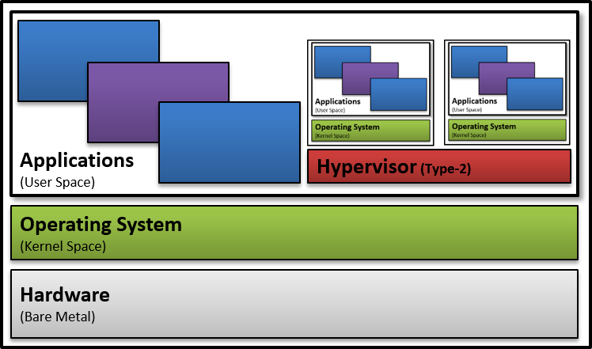
Type-2 Hypervisors
Resides above the host operating system
Existing Products:
VMware Workstation
VMware Fusion
Parallels Desktop
Oracle VirtualBox
QEMU
Bochs
Microsoft Virtual PC
Can leverage hardware facilities (e.g. ARM VE, Intel VT or AMD SVM)

Slide 9
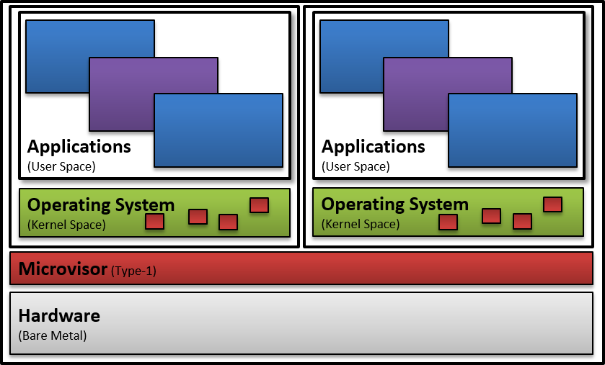
Microvisors
Existing Products:
Open Kernel Labs (OKL)4
CODEZERO
Paravirtualization
Requires source code modifications (e.g. hypercalls)
Adding the hypercalls to an OS is similar to adding support for a new architecture
Twists architectural features to provide an additional layer of separation
Domain separation on ARM, de-privilege the VM OS (runs completely in user space)
VM user space and kernel space are separated into different domains
x86 hypervisors used segmentation to provide an additional layer of separation

Slide 10
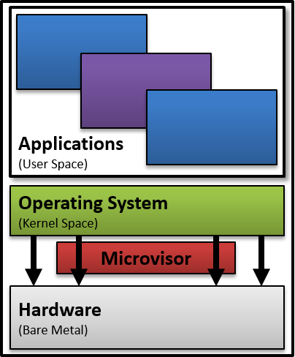
Thin Virtualization (VERTIGO’s Usage)
Supports only a single OS, not intended to completely virtualize a system
Leverage features and techniques of virtualization to accomplish tasks
Does not require source code modifications of the underlying OS
Uses para-passthrough techniques to maintain control without adversely affecting performance

Slide 11
Microvisor Overview
An Overview of the microvisor and its components.

Slide 12
Overview
VERTIGO – Virtualized Extendable Runtime Transport for Integrated Germane Operations
Dynamically lifts a running commodity Operating System (OS) into a state analogous to a virtual machine (VM)
Leverages only architectural features in the kernel to maintain broad compatibility with Cortex-A series processors and their supported OSs
Constructed as a position independent flat binary to facilitate novel loading methods, such as kernel exploits

Slide 13
Features
Kernel features include a:
Dynamic Linker
Vector Dispatcher
¼ Size Paging Subsystem
Memory Allocation Subsystem
Debugging Subsystem
Numerous API to manipulate ARM architecture primitives
Supports runtime linking and module loading via a hidden communications channel
The kernel is kept generalized and modules are intended to load use-case specific code
Import API from the kernel and other modules
Export API for other modules

Slide 14
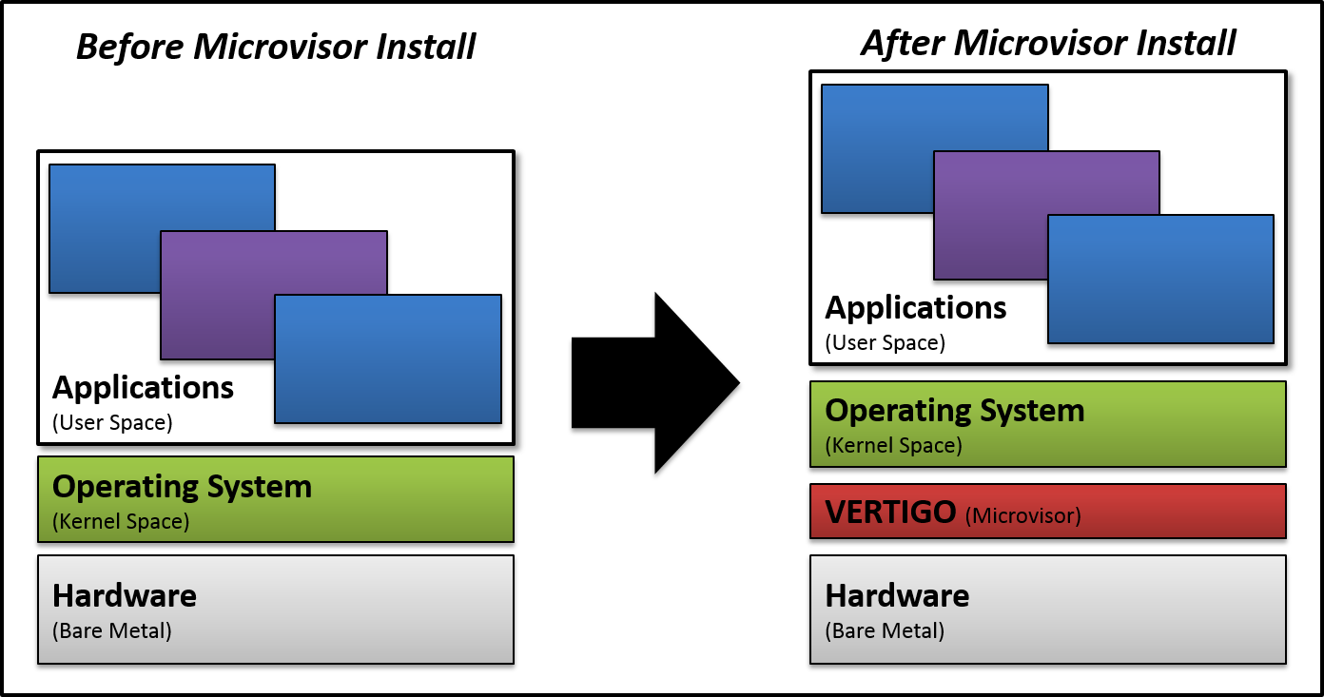
Installation
Microvisor Requirements:
ARM Cortex A series SoC (tested on the A8 and A9)
A chunk of virtually contagious non-pageable memory
Execution in supervisor mode
Supports a single commodity OS at a time
Does not use any API in the underlying OS
Installs itself on a live system by dynamically lifting the running OS in to a state analogous to a virtual machine
Minimal requirements allow the microvisor to maintain clean separation from its underlying OS, facilitating portability between devices

Slide 15
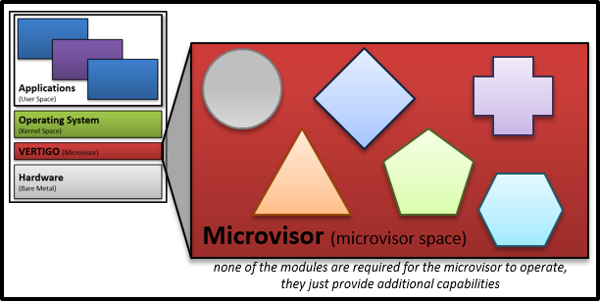
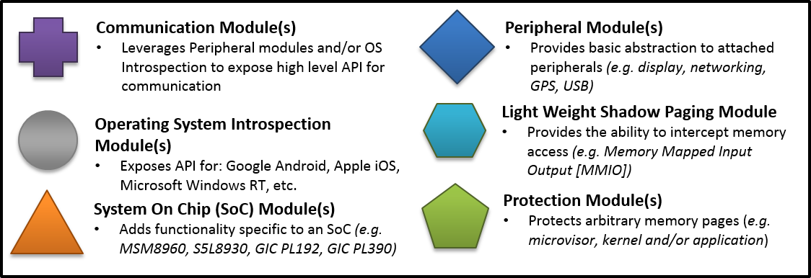
Modularity
Modules will be used to allow the microvisor to expand its footprint on the system once details have been identified (e.g. leverage peripherals, OS API)
Modularity is key to enable code reusability
SoCs and OSs are commonly interchanged
SoC X is used with OS Y and OS Z : OS X is used with SoC Y and SoC Z

Slide 16




Support
Tested with the Apple iPhone 4 (iOS 5.0.1 and 5.1.1) and the Samsung Galaxy SIII (Android 4.0.4)
It is installed at run-time through an OS specific loader
On iOS it is a user space application that will inject the microvisor into kernel space
On Android it is a kernel module
Any privilege escalation technique could be tailored to accommodate microvisor loading

Slide 17
Kernel’s Key Enabling Components
Main points of the kernel. Highlights some of the more interesting parts of the microvisor.

Slide 18
Flat Binary
A flat binary is a very plain file format in the context of this project it contains code and data
Constructing the microvisor as a flat binary provides separation the underlying OS and encourages portability
Common examples of this are shell code and boot loaders
It does not retain any structures or sections from the build process (e.g. import tables, file format headers [elf, pe, etc.])
All sections are collapsed and placed back to back during the linking stage (e.g. text, bss, data, rodata, LC0)
Not all sections are included in the file as some are unnecessary
The runtime base address of the binary can be specified in a linker script, if known
If the runtime base address is unknown (most cases, right ☺) global address in the binary file will be incorrect
Specifically, global variable and function addresses (e.g. &function) are incorrect at runtime

Slide 19
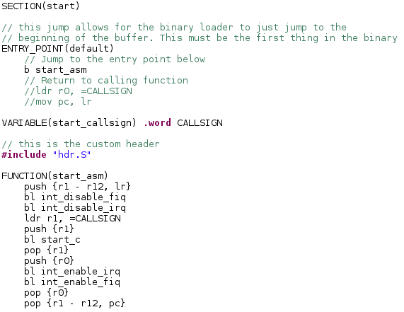
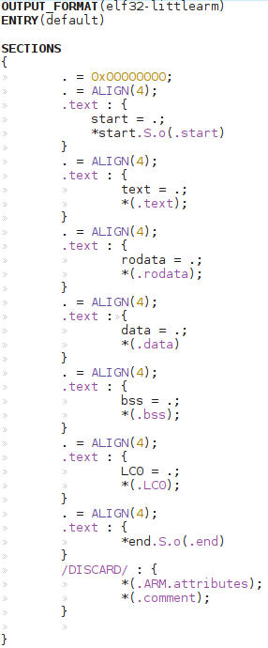
Linker Script
The linker script (right side) shows how to manually specify the layout of a binary at link time
Constructing a flat binary is a multistage process
Create object files (i.e. gcc –c option)
Create an elf file by using the ld command (bottom left)
Create the flat binary by using objcopy (bottom left)
The linker script also identifies a couple custom sections (i.e. start and end) this allows for an entry point to be placed at the top of the file (top left), and a identifier at the end of it
Steps 2 and 3 can be collapsed but having an elf version makes debugging easier, as it can be loaded into objdump, ida pro and other debugging tools

Slide 20
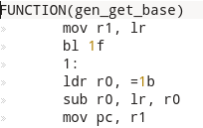
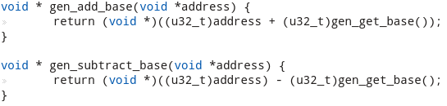

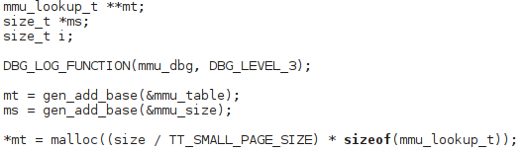
Position Independence
This fixes incorrect global variable and function addresses at runtime
Gaining position independence in this type of a build system is relatively easy
Stack variables are not a concern as they will be correct at runtime
The base address of the binary should be set to 0 in the linker script
To resolve an address at runtime, add the link time address to the runtime base address of the binary
An assembly function is used to obtain the base address of the binary at runtime
It uses the branch with link instruction to store the PC address of the 1 label in the link register
Loads the link time address of the 1 label into r0
Subtracts the two and returns it in r0
The C functions abstract the assembly function and add the runtime base address of the binary to any a link time address and obtain a valid runtime address
Combining a flat binary and position independence creates a perfect environment for constructing complex OS independent applications

Slide 21
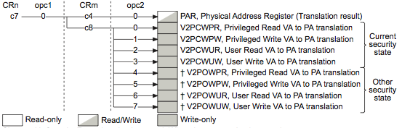
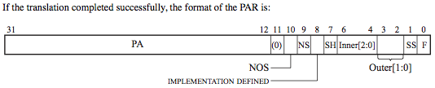
Brute Force Address Translation
The ARMv7 architecture provides the ability to perform virtual to physical address translations using co-processor 15
This feature eliminates the need for the loader and microvisor to use OS specific API or knowledge to obtain translations of memory
This feature can be reversed to translate a physical address to a virtual address
This feature eliminates a circular dependency associated with constructing and loading a paging system
Translation Table Base Registers (TTBRs) and descriptors use physical addresses
Translation is needed to set the TTBR correctly
x86 does not provide this mechanism and requires OS API to provide translations before launching a microvisor

Slide 22
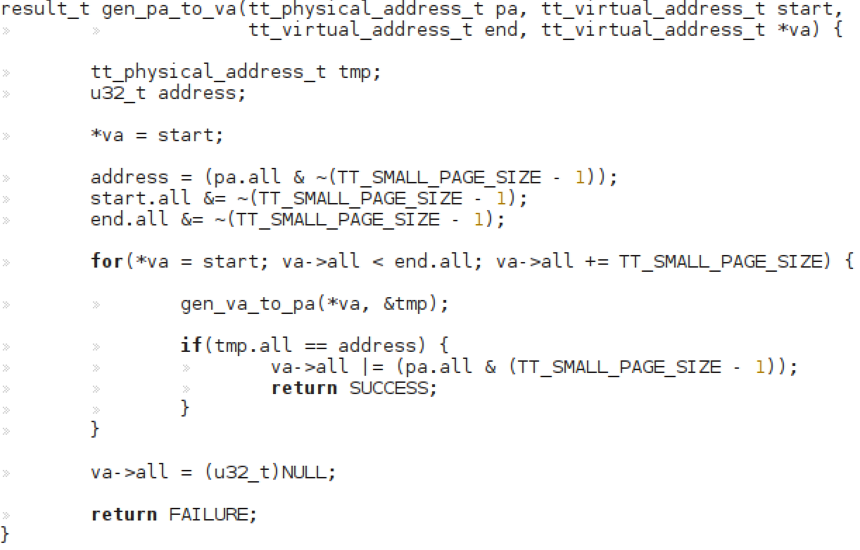
Brute Force Address Translation
Start at a base virtual address and loop until the physical address matches the one passed in or the end virtual address is reached
Basic algorithm, just translate virtual addresses beginning at the start virtual address and ending at the end virtual address
If a virtual address translates to the physical address of interest return the translation and SUCCESS, else continue
If the end address is reached return FAILURE and NULL
Co-processor 15 does not always identify the page size associated with a translation
Only tells if the page is a supersection or not
This could be used improve performance of the algorithm
Page size doesn’t matter, the algorithm can just be generalized to assume all pages are small
smallest page mapping available in the translation tables

Slide 23
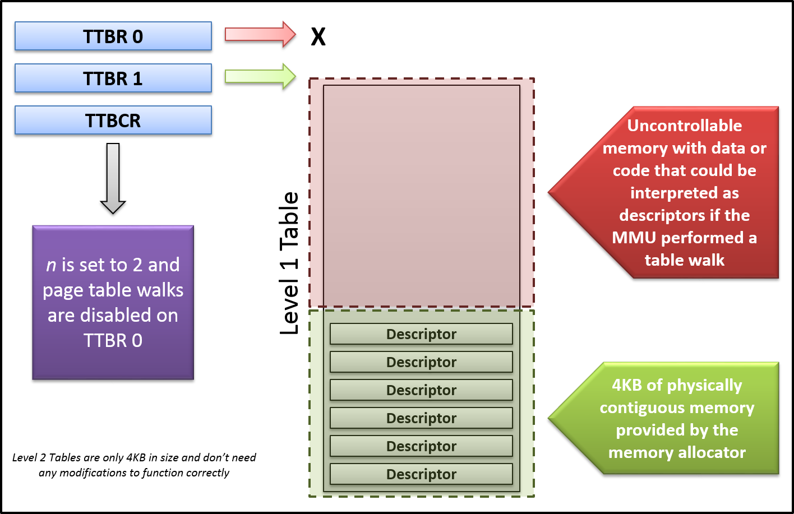
¼ Size Paging Subsystem
A paging system allows for the microvisor to map any physical memory
This can be used to communicate with peripherals or manipulate the underlying OS in a generic way
Ability to modify the OS’s page tables
Maintains an identity map between the OS’s paging system where the microvisor was loaded
The virtual memory address space is limited to 1GB
Addresses can range from 3GB to 4GB
Only requires 4KB of physically contiguous memory
The size of a small page of memory
Means that any kernel memory allocator can be used (e.g. vmalloc or kmalloc)
Can map either sections or small pages

Slide 24
Vector Table Modifications
Modifying the vector table allows the microvisor to gain control when hardware events occur before the underlying OS
Apple iOS and Linux mark the page that holds the vector table as read-only
The microvisor’s paging system is used to map the physical memory that the vector table resides on to a different virtual address that is writable
The instructions in the table are all control flow instruction of some kind so a small decoder is used to construct an absolute address of the OS’s vector handlers
The addresses are needed so the system can reflect exceptions and interrupts into the underlying kernel as required
The table is then replaced to direct all exceptions and interrupts to the microvisor

Slide 25
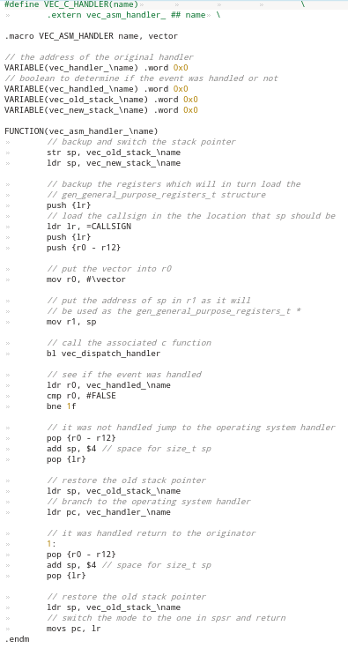
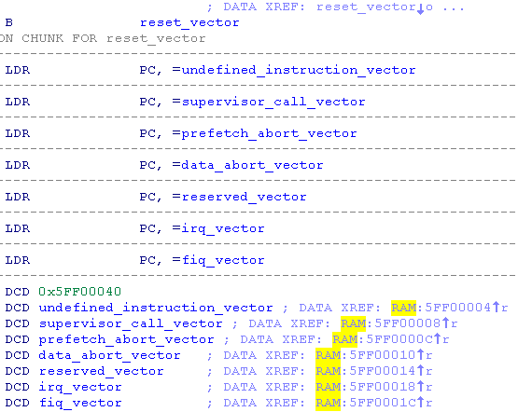
Vector Table Modifications
Macro used as the entry point for the exception and interrupt vectors
The vector table in the Low Level Bootloader (LLB) on the iphone 4

Slide 26
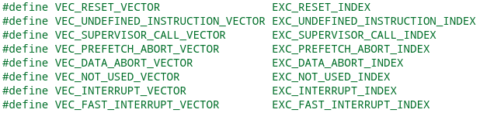
Vector Table Modifications
The vector subsystem allows others, such as the dynamic linker and modules, to register at runtime and receive exceptions and interrupts
Implements a linked list to hold registered handlers and the dispatcher just loops until the list is exhausted
Handlers notify the dispatcher if the event should be reflected into the underlying OS or not
Register state is passed as a parameter and allows for easy modification and inspection

Slide 27
Dynamic Linker
The microvisor contains a dynamic linker that allows modules to utilize kernel API and API provided by other loaded modules
When modules are loaded and unloaded from the microvisor their init and fini function are called
Functionality is invoked by executing a unique undefined instruction and setting registers to specific values
The undefined instruction dispatcher will then pass execution to the linker and load, unload or list the currently loaded modules
When a module is being loaded the linker will:
Allocate space in the microvisor and copy the binary from user space
Parse the module header and patch the import table as needed to link required API
If a function is not found in the microvisor the module will not be loaded and the linker will error gracefully
Add any export functions defined by the module to a list so other modules can utilize them
The modules init function will be called
When unloaded the linker will:
Reverse the actions of the loader
When listing is requested the linker will:
Pass via registers information about each module
Module entry points follow the standard C main prototype
Parameters are passable via the undefined instruction exception when the module is loaded and unloaded
Different arguments can be passed when loaded and unloaded
result_t init (size_t argc, u8_t *argv[]);
result_t fini (size_t argc, u8_t *argv[]);
void init (void);
void fini (void);

Slide 28
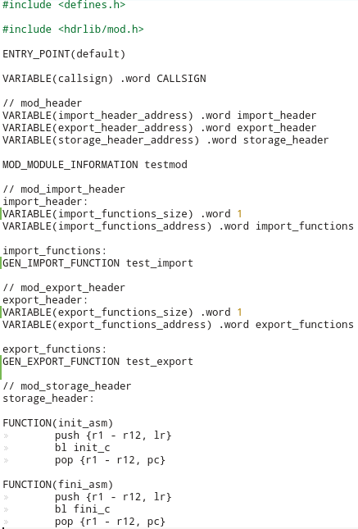
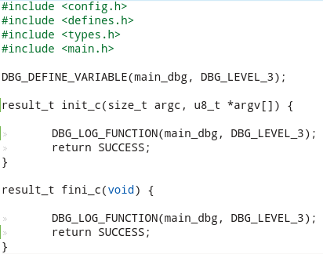
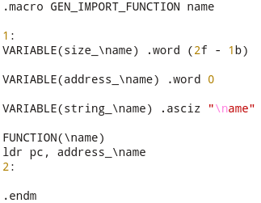
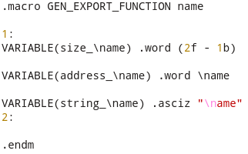
Module Template
Also constructed as a flat binary with a custom header. Similar to the microvisor
C functions called when loaded and unloaded
Macro used to import functions into the module at runtime
Macro used to export functions from the module so other modules can import them at runtime

Slide 29
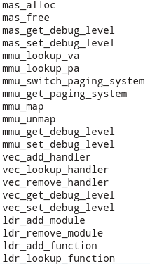

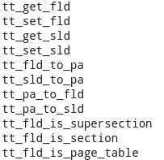

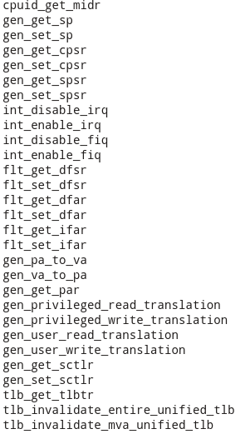

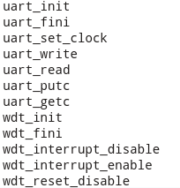
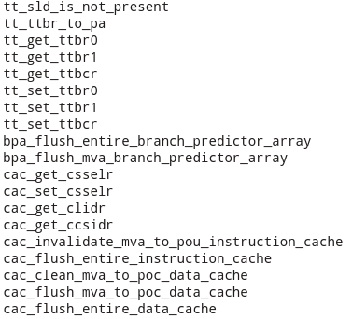
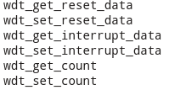





Exposed Microvisor Kernel API

Slide 30
Loaders Exposed
Explanation of how loading is accomplished on both Apple iOS and Google Android.

Slide 31
Apple iOS Loader (Jailbroken)
Currently Apple iOS does not provide the ability to install kernel modules even when the device is jailbroken
It uses a cached version of the kernel that has all the modules loaded, thus eliminating the need for loadable module support
The loader performs the following actions in user space
Allocates non-executable memory in kernel space
Copies the core microvisor into it
Initialized the serial port to 115200 baud rate
Patches a function pointer in the system call table
Makes a system call to execute the function it patched into the system call table with supervisor privilege (i.e. kernel mode)
While Mach system calls were used to accomplish the task it is analogous to using mmap and “/dev/kmem” on Linux
The basic requirement is just the ability to perform arbitrary kernel memory reads and writes
Specific functions used include task_for_pid, mach_self_task, vm_read_overwrite, vm_write and vm_allocate
Jailbreak code from Comex was referenced

Slide 32
Apple iOS Loader (Jailbroken)
Once executing in kernel space the following actions are performed before jumping to the microvisor
The correct translation table base address is obtained and a brute force physical to virtual address translation is performed
The level 1 OS page table is then walked to find the descriptors associated with the memory allocated in user space for the microvisor
This involves performing brute force translations on level 2 tables when required
The descriptors are then modified to make them executable and writable (neuter XN)
When the microvisor finishes initialization the loader returns to user space and does the following
Patches the system call table again to restore the original entry
Drops into an infinite loop to maintain the serial port settings (can be removed if not debugging with the UART)
No kernel API were harmed or used to perform the required actions, only architectural features were leveraged

Slide 33
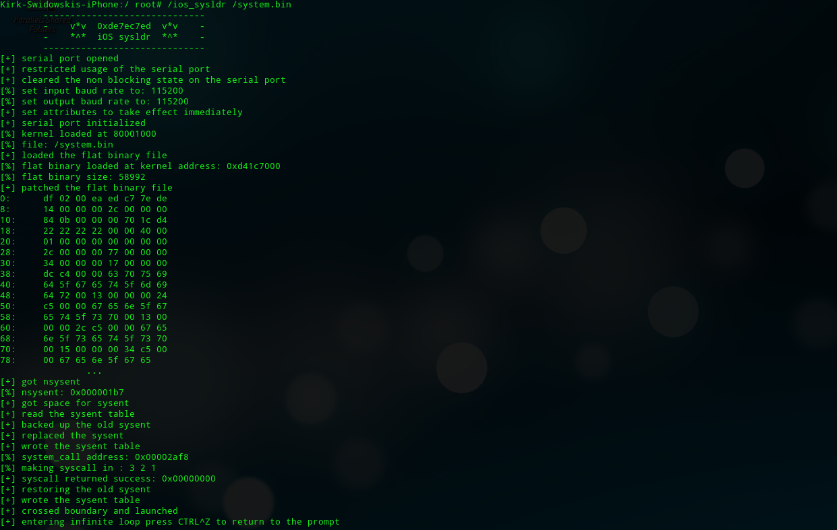
Apple iOS Loader (Jailbroken)

Slide 34
Android Loader (rooted)
Constructed as a kernel module
Disables secondary processor core on the Samsung SIII
This may not be required but makes debugging easier
Propagates page mappings throughout the systems address spaces
This is required because the microvisor hooks the vector table and needs to make sure that its memory is mapped in all the address spaces
If Linux used ttbr1 correctly this wouldn’t be required
Reads the microvisor kernel into memory from a file
Disclaimer: Don’t do this in legit kernel modules as the Linux community will be very upset (something about separation of policy and mechanism)
Using the File I/O API from within the Kernel is a no-no!
Linux kernel (No = File I/O, Yes = Process Creation) Windows Kernel (No = Process Creation, Yes = File I/O)
SYS$OUTPUT blog and code referenced

Slide 35
Modules & Management
Existing modules and the unprivileged user space management applications.

Slide 36
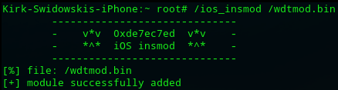
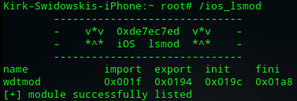
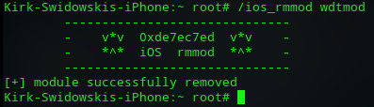
Management Applications
Three user space applications can be used to install, remove and list the modules (i.e. ios_insmod, ios_rmmod, ios_lsmod)
All the programs are very basic and just throw undefined instruction exceptions to communicate with the underlying microvisor
Microvisor catches the exception and returns execution to the originating code without notifying the underlying OS kernel
They can be quickly ported to other ARM OSs with little effort
Ported from iOS to Android in less than an hour
Anything that can induce the required undefined instruction exception can manage modules (i.e. the loader could automatically add additional modules at installation time)

Slide 37
Modules
Breakpoint Module
Set breakpoints and singlestep any underlying code including kernel API, FIQ handlers, IRQ handlers, etc.
Supports both ARM and Thumb mode
Exports API to register and unregister handlers
Light Weight Shadow Paging Module
Monitor any MMIO on the system
Exports API to register and unregister handlers
This is currently used to aid in reverse engineering of hardware peripherals
Linux Module
Finds and maintains links to kernel API
Exports API to call many useful kernel functions, such as:
kmalloc
kfree
printk
call_usermodehelper_setup
call_usermodehelper_exec
schedule
create_proc_entry
remove_proc_entry

Slide 38
Modules
SOC Modules
MSM8960 (Samsung Galsxy SIII) [Qualcomm SoC]
S5L8930 (Apple iPhone 4) [Samsung SoC]
Will only load on the correct hardware (uses something analogous to CPUID on x86)
Exposes SoC specific API (e.g. UART, watchdog)
Cryptography Module
Provides API for two implementations of AES-128 (s-box and table based)
Provides API for SHA-1
PL192 Module
Exposes API to interact with the PrimeCell PL192 Vectored Interrupt Controller
Reflect software interrupts into the underlying OS
Disable Interrupts
Set if an interrupt is ran in IRQ or FIQ mode

Slide 39
Modules
Watchdog Module
Disables the watchdog timer and intermittently checks to make sure it has not been re-enabled by the underlying OS.
The watchdog timer is a custom format and does not match up to any SoC datasheets I had access to.
Development of this module involved:
Static analysis of the LLB, iBoot and the iOS kernel.
Dynamic analysis using the shadow paging and breakpoint modules.
Paging Module
Print out all page table descriptors that meet a set of attributes
It was used to find the base addresses of all potential MMIO on the iPhone 4
It was later verified by a modified python script that parsed the DeviceTree.img3 file in the IPSW package.
The version online did not work on newer iOS devices and needed to be updated
The script provided the entire MMIO, VIC and GPIO layout among other things

Slide 40
Debugging Facilities
Software debugging facilities and custom hardware cables.

Slide 41
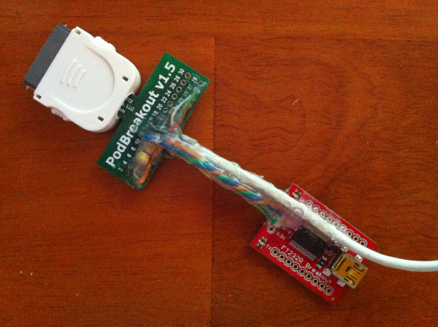
Apple iPhone 4 Debugging
UART 0 on the iPhone 4 resides at physical address 0x82500000
The virtual address in kernel space was found by using co-processor 15’s ability to perform memory address translations (unique brute force approach)
Knowing that the iPhone 4 (S5L8930) is a Samsung SoC another Samsung SoC’s datasheet was used to develop a UART library (the register layout is the same)
The UART on older iDevices is exposed through the bottom connector (pin 12 is TX and 13 is RX)
A 470K ohm pull down resister is connected across pin 1 and 21 to enable the UART.
Referenced “Targeting the iOS Kernel” by Stefan Esser for the hardware

Slide 42
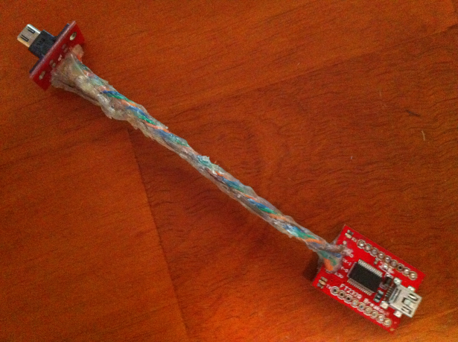
Samsung Galaxy SIII Debugging
A 525K ohm pull down resister is connected across the ID and GND pins of the USB port to enable the UART
Works with minicom and other serial console applications
UART 0 on the Galaxy SIII resides at physical address 0x16440000
The virtual address in kernel space was found by using co-processor 15’s ability to perform memory address translations (unique brute force approach)
Knowing that the USA version of the Samsung Galaxy SIII is built with a Qualcomm SoC (msm8960) another Qualcomm SoC’s datasheet was used to develop a UART library as the register layout was similar
A potentiometer was used to find the correct resistance level
Multiple resistance levels enable the UART (they output different messages)

Slide 43
Construction & Layout
Repository layout and build commands are provided

Slide 44
Downloading & Building
VERTIGO consists of a number of git repositories
The easiest way to checkout the code is to type “git clone https://github.com/de7ec7ed/vertigo.git” from a terminal
This repository does not contain any code other than a Makefile
To checkout the repositories for VERTIGO type “make clone”
Once everything is checked out type “make PREFIX=arm-linux-gnu-”
arm-linux-gnu- is the prefix of your tool chain (e.g. arm-linux-gnu-gcc)
Ubuntu this can be installed by typing “apt-get install gcc-arm-linux-gnueabi”
Fedora this can be installed by typing “yum install gcc-arm-linux-gnu.x86_64”

Slide 45
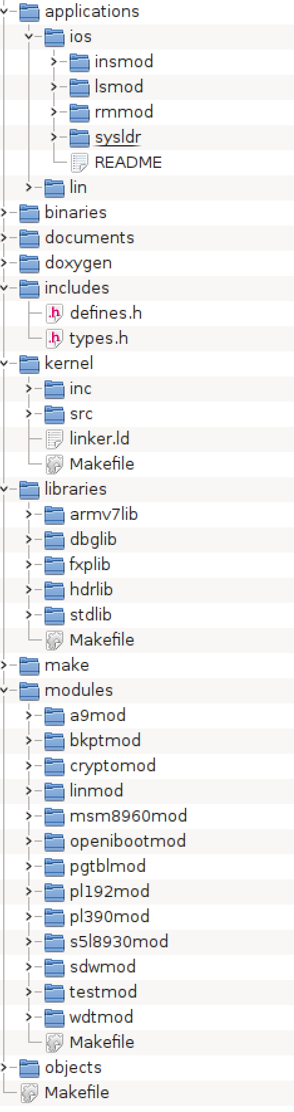
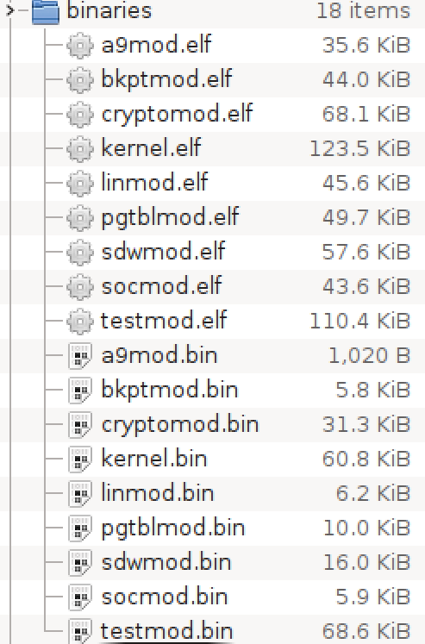
Repository Layout & Binary Sizes
OS specific applications to install and work with modules and the microvisor.
ELF versions are useful for debugging (subtract the runtime base to locate things in the ELF file)
Contains a copy of the includes from the libraries, kernel and modules
The kernel
Statically linked libraries that are built into the kernel
Kernel is only 60.8 KB (includes 6.9 KB of strings most are for debugging)
Modules that can be linked into the kernel at runtime
Average module is 10.88 KB

Slide 46
Questions
Kirk Swidowski
mail kirk@swidowski.com
web www.de7ec7ed.com
twitter de7ec7ed
github github.com/de7ec7ed

